Slide 1

Predicting Cascading Failures in Smart Grids
Rezoan Ahmed Shuvro
Ph.D. Candidate, Marquette University, Milwaukee, WI

Slide 2

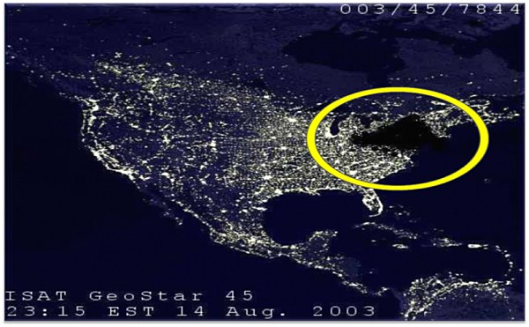
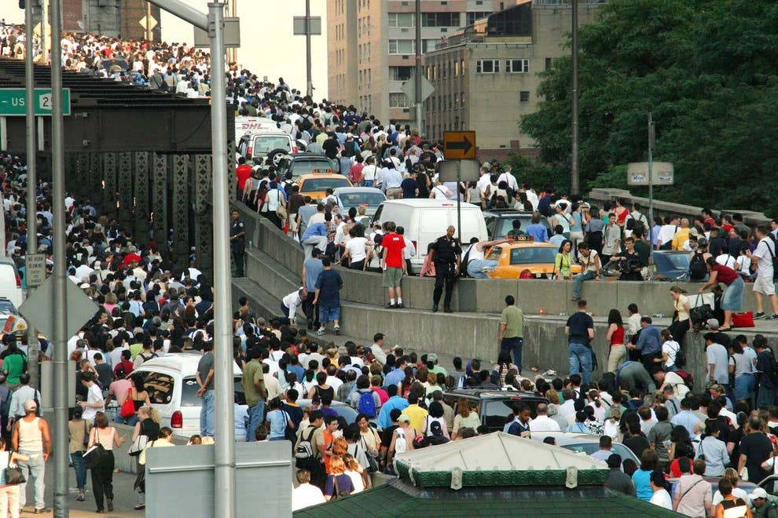

Grids are reliable but blackouts occur
https://www.npr.org/2013/08/14/210620446/10-years-after-the-blackout-how-has-the-power-grid-changed
https://blog.cheaperthandirt.com/survive-summer-power-outage/
https://www.buzzfeednews.com/article/gabrielsanchez/2003-blackout-new-york-city-without-power
https://www.amny.com/news/northeast-blackout-2003-1-20432049/

Slide 3
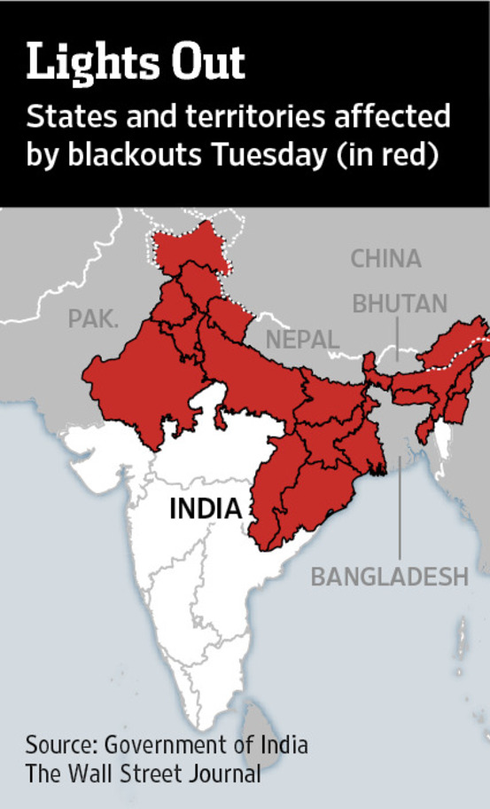
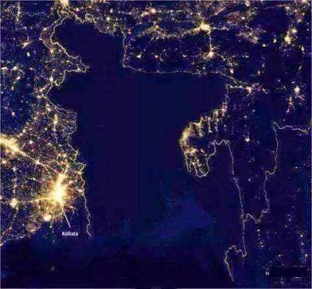


A global problem
2012 India Blackout
2014 Bangladesh Blackout
wsj.com/articles/SB10000872396390444405804577560413178678898
http://theevolutionandpresentdayofbangladesh.blogspot.com/2014/11/blackout-in-entire-country-people-of.html
2015 Ukraine Blackout
2019 Java Blackout
https://www.dailykos.com/stories/2018/3/16/1749595/-Ukraine-was-Putin-s-Trial-Run
https://www.nst.com.my/world/2019/08/510124/power-restored-java-after-12-hour-blackout

Slide 4
Outline
Background & motivation for this work
Data collection and feature engineering
Data cleaning and visualizations
Model tuning, discussion and results
Conclusions and extensions

Slide 5


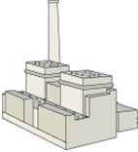

Interdependent multi-layer view of the smart grid
Control operators
Human,
computer
Wireless
3/4G, WiMAX, LTE
Wired
IP, optical
Communication
Network
Generation
(plants, green, storage)
Power Grid
Infrastructure
Power
substation
Distribution
Transmission
Distribution
Notes:
OPGW
Power line communication (PLC)
Wireless communication

Slide 6
Cascading failures in power grid : overview
Loads shifted to nearby elements in the system
Nearby elements are overloaded beyond their capacity
Elements are tripped; load are shifted onto other elements
Cascading chain of failures starts, which can lead to system blackout
A few lines/generators trip initially
Source: Wikipedia

Slide 7
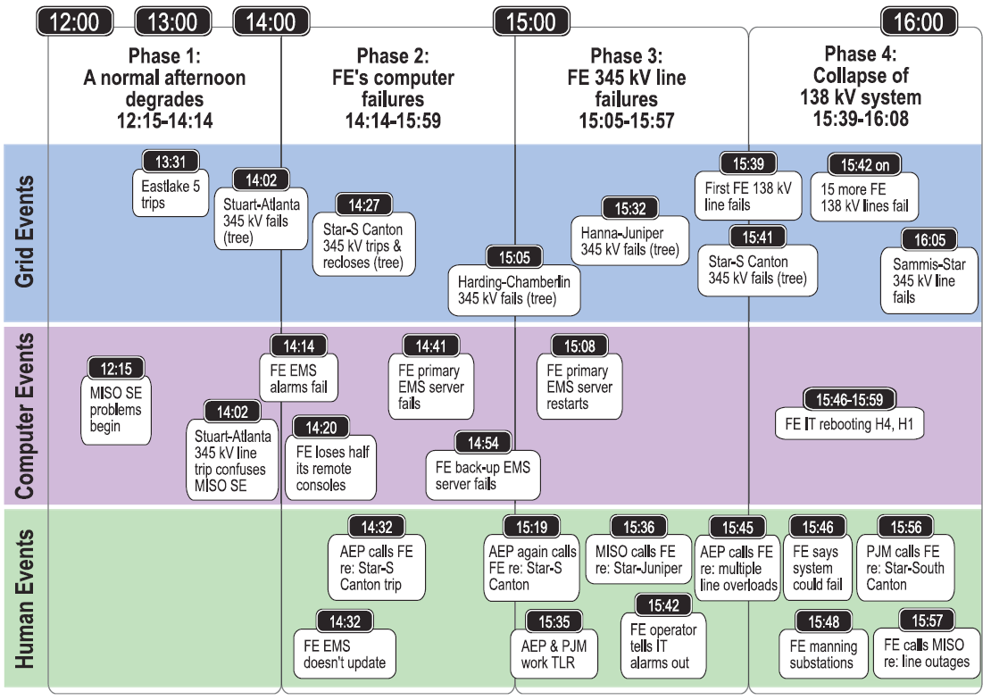
Understanding large blackouts: known causes
2003 Northeast Blackout
Occurred due to combination of transmission
line and communication network failures.
Alarm software failed, left human operators
unaware of transmission-line outage and
resulting confusion and misjudgment led to
cascading failures [1].
2011 South East Blackout (San Diego and AZ)
Technician accidentally shut 500-kv transmission line which lead to a blackout affecting 11 million people over 11 hours. Estimated losses in $12-$18M range [3].
2015 Ukraine Blackout
In 2015, cyber attackers gained access to the Ukraine power grid using malware and eventually attacked the grid and did massive outage affecting 0.25 million subscribers.
[1] U.S.-Canada System Outage Task Force, Princeton, NJ, USA, “Final Report on the August 14th Blackout in the United States and Canada 2004
[2] https://www.ferc.gov/legal/staff-reports/04-27-2012-ferc-nerc-report.pdf
[3] D. U. Case, “Analysis of the cyber attack on the Ukrainian power grid, "Electricity Information Sharing and Analysis Center (E-ISAC), 2016.
Notes:
Union of Concerned Scientists

Slide 8


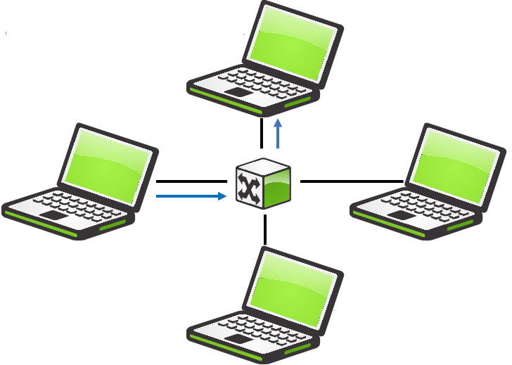
Overview of cascading failure dynamics
Dynamical and stochastic cascading failures behavior
Power-grid loading level, r
Load-shedding constraint level, θ
Line-capacity estimation error, e
Power grid operating parameters
Power grid
Internal dynamics
Power-communication interdependency
Communication / control network
internal dynamics
Human operator
response
Power-operator
interdependency
Communication-operator
interdependency
Initial event
Natural, human error, WMD
Cascading Failures

Slide 9
Motivations
Contributions
Limited real-world data
Generating synthetic cascade data using DC/AC optimal power flow formulations
Feature engineering
Development of a cascading failure simulation framework
Classification of cascading failures in power grids
Predicting cascading failures (from line failures and load-shedding) using regression
Utilities can use this model to mitigate the risk of cascading failures during planning phase.
Significantly reduces the computational time.

Slide 10
Data collection: flowchart of the simulation framework
Dataset:
A 66817 X 19 Matrix with 16 features using IEEE 118 bus system (186 lines and max generation of 9966MW).
Target:
Amount of Load-shedding
Total Number of line fail
Cascading effect
Source:
MATLAB using MATPOWER [1] power-flow m-files.
Computation time: 556 hrs.
Initial power-grid state
Any islands triggered from failures?
Initial event triggering failures in power grid
Solve the power flow optimization problem for each island
Yes
Remove failed lines
Solve power flow optimization problem
No
Power lines overloaded?
No
Finish
Remove the overloaded lines from the system
Yes
1. Zimmerman, R. D., Murillo-Sánchez, C. E., & Thomas, R. J. (2011). MATPOWER: Steady-state operations, planning, and analysis tools for power systems research and education. IEEE Transactions on power systems, 26(1), 12-19.

Slide 11
Data collection: flowchart of the simulation framework
Dataset:
A 66817 X 19 Matrix with 16 features using IEEE 118 bus system (186 lines and max generation of 9966MW).
Target:
Amount of Load-shedding
Total Number of line fail
Cascading effect
Source:
MATLAB using MATPOWER [1] power-flow m-files.
Computation time: 556 hrs.
Initial power-grid state
Any islands triggered from failures?
Initial event triggering failures in power grid
Solve the power flow optimization problem for each island
Yes
Remove failed lines
Solve power flow optimization problem
No
Power lines overloaded?
No
Finish
Remove the overloaded lines from the system
Yes
1. Zimmerman, R. D., Murillo-Sánchez, C. E., & Thomas, R. J. (2011). MATPOWER: Steady-state operations, planning, and analysis tools for power systems research and education. IEEE Transactions on power systems, 26(1), 12-19.

Slide 12
Feature selection and engineering
Regular features
Capacity of the lines
Generation, demand
Engineered Features
Total, maximum, minimum capacity of the failed lines
Ratio between load and maximum generation
Costs of load-shedding
Operator attributes
Topology of the grid
Load-shedding constraint
Human error Probability
Average degree, distance
Total number of line fail, amount of load-shedding
Cascading effect (linear combination of the target variable after scaling)
Features | Feature Remarks
Initial number failed lines | Regular feature
Generation | Regular feature
Demand | Regular feature
Served load | Regular feature
Capacity estimation error, alpha | Regular feature (uncertainty of information)
Flow capacity | Regular feature
Islands | Regular feature
Total Number of line fail | Target
Amount of load-shedding | Target

Slide 13
Data cleaning
Duplicate Records – No duplicate records since the dataset is simulated
Null Values – No null records since the dataset is simulated
Outliers – No outliers since the dataset is simulated

Slide 14
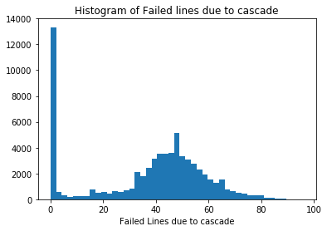
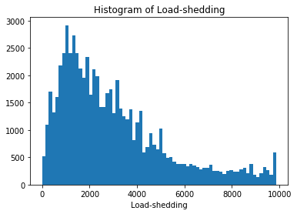
Exploratory data analysis: data visualizations
Less probability of high load-shedding
Gaussian in nature
No additional failures

Slide 15
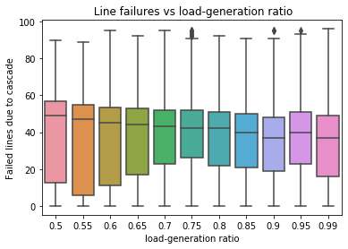
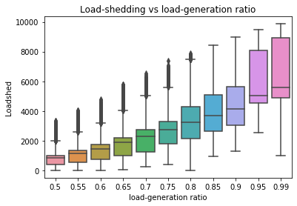
Exploratory data analysis: Data Visualizations
The mean of line failure remains almost the same while the amount of loadshedding increases significantly with higher load-generation ratio.

Slide 16
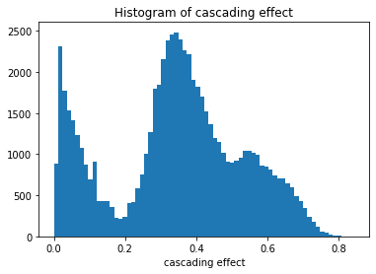
Exploratory data analysis: data visualizations
Histogram of the cascading effect shows bimodal nature. The first peak is due to no line failure scenarios and the second peak captures the average effect of line failures and loadshedding

Slide 17
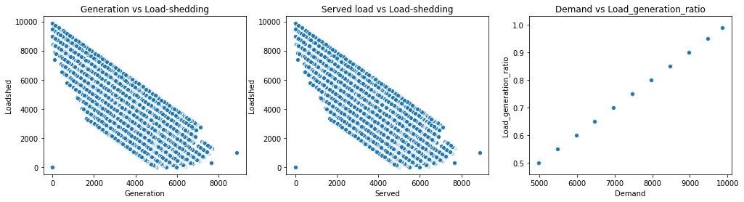
Exploratory data analysis: pruning features/dimensionality reduction
Load features
Decision: Removed generation, served, demand from the dataset to avoid collinearity
Rationale: scatterplot above shows linear correlation.

Slide 18
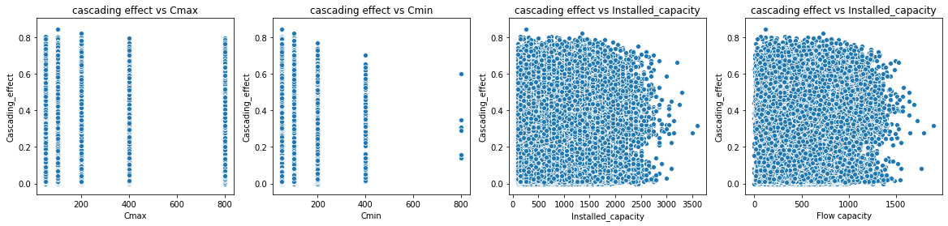
Exploratory data analysis: pruning features/dimensionality reduction
Capacity features
Decision: We can remove this four features from the data set as well. But for now Cmax, Cmin are kept and the other two are deleted. We may delete them later during model tuning. Rationale: There is no visible patterns between Cmax, Cmin, Installed capacity, Flow capacity with cascading failure.

Slide 19
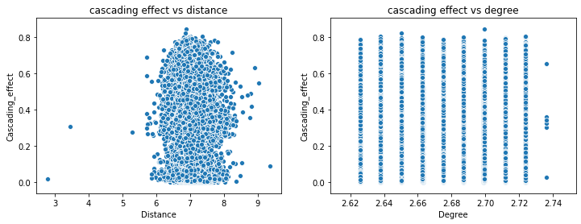
Decision: We can remove this two features from the data set as well. But i will keep them for now and may delete them during model tuning. Rationale: There is no visible patterns between degree and distance with cascading failure.
Exploratory data analysis: pruning features/dimensionality reduction
Topological features

Slide 20
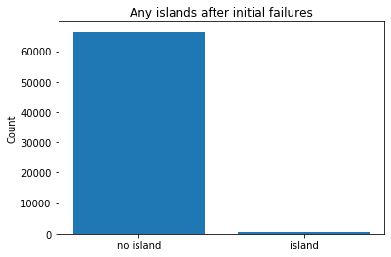
Exploratory data analysis: pruning features/dimensionality reduction
Finally, removed failed lines after cascade ends and load-shed features since cascading effect is obtained from their linear combinations.
Decision: Removed islands feature From dataset
Rationale: Bar chart above shows no islands formed after initial failures in most cases.

Slide 21
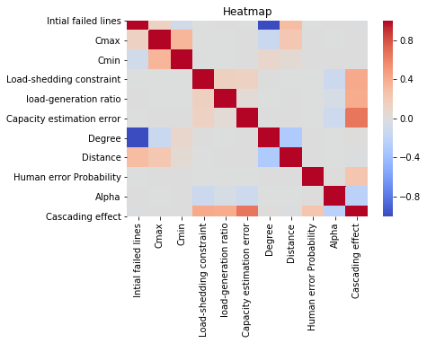
Exploratory data analysis: correlation between features
Strong correlation with cascading effect:
Capacity estimation error
Moderate correlation with cascading effect:
Load-generation ratio
Load-shedding constraint
Human error probability
Alpha(negative correlation)
Low/minimal Correlation with cascading effect:
Cmax, Cmin
Degree, distance
Initially failed lines

Slide 22
Modeling : (ML algorithms and modeling steps)
Steps used for modeling:
Algorithms for regression:
Linear regression/ Ridge/Lasso regression
Random Forest regression
Support vector regressor
Train-test split and separate test data
Use a 2nd train-test split and use 5-fold cross-validation on the training data
Remove the redundant features like Cmax, Cmin and others one after another and compare accuracy
If the accuracy is not affected, then prune that feature; Else keep it.
Update the data set after all the pruning, Fit model using the updated dataset and find final accuracy using the original data
Algorithms for classification:
Logistic regression
KNN (k nearest neighbor)
Random forest
Decision tree
Support vector machine
Adaboost
Regression metric:
r-squared score.
mean absolute error
mean square error
Classification Metric:
Accuracy
Precision
Recall
F1-score

Slide 23
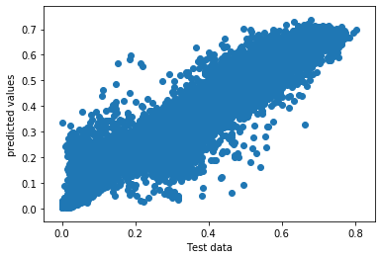
Regression model to predict cascading effect
Random forest regression worked best.
r-squared of 0.91 found after hyperparameter tuning ( n_estimators = 300, min_samples_split=10, min_samples_leaf=10)
Predicted vs test data showing linear trend (random forest regressor)

Slide 24
Classification of cascading failures
No cascade: cascading effect < mean of cascading effect
Cascade: cascading effect >= mean of cascading effect
Model | Best hyperparameters
Decision tree | 'criterion': 'entropy’, 'min_samples_leaf': 10, 'min_samples_split': 5
KNN | 'algorithm': 'auto’,'leaf_size': 1, 'n_neighbors': 10, 'weights': 'distance'
Adaboost | 'algorithm': 'SAMME.R', 'learning_rate': 0.5, 'n_estimators': 200
Random forest | 'criterion': 'gini', 'min_samples_leaf': 5, 'min_samples_split': 5, 'n_estimators': 50
Logistic regression | C= 10 (penalty =‘l2’)
SVM | 'C’: 5, 'kernel': ['rbf']
Random forest best accuracy
Decision tree gave the best improvement after feature tuning

Slide 25
Predicting cascading failures (classification report with tuned features)
- Model could predict the cascade/no cascade classes with high precision and recall.

Slide 26
- Machine learning algorithms were used to predict cascading failures in smart grids. - We would use random forest for classification and regression for production because of high accuracy and a wide variety of hyperparameter tuning opportunities. - Modeling effort reduces computational time. - Utilities can use this model to mitigate the risk of cascading failures during planning phase.
Summary
Summary

Slide 27



THANK YOU
QUESTIONS
Outline
Background
Contribution
Data Collection
Feature engineering
Data Cleaning
Exploratory data analysis
Heatmap
Modeling
Regression
Classification
Summary

Slide 28
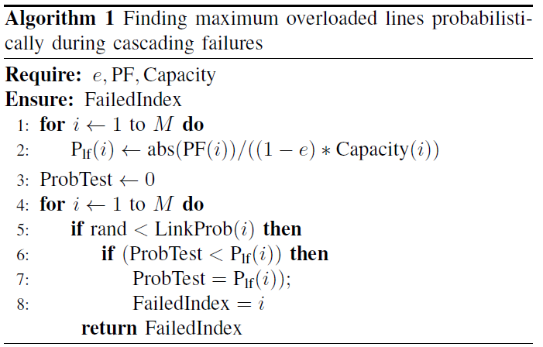
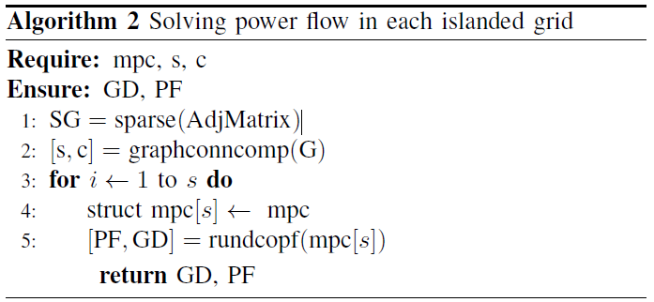
Annex1: Algorithms for cascading failure simulation
Algorithms used to find the maximum overloaded line in one iteration and solving power flow in each island.

Slide 29
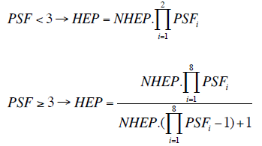
Annex2: HEP Calculation Using SPAR-H Methodology
SPAR-H PSFs | SPAR-H PSF Levels | Multiplier | Pr.(escalation)
Diagnosis / Action |  | 0.01/0.001
Available time | Inadequate time | 1 | 0.0
 | Time available = time required | 10 | 0.9
 | Nominal time | 1 | 0.1
 | Time available≥ 5x time required | 0.1 | 0.0
 | Time available > 50x time required | 0.01 | 0.0
Stress/Stressors | Extreme | 5 | 0.4
 | High | 2 | 0.6
 | Nominal | 1 | 0.0
Complexity | Highly complex | 5 | 0.4
 | Moderately complex | 2 | 0.6
 | Nominal | 1 | 0.0
 | Obvious diagnosis | 0.1 | 0.0
Experience | Low | 10 | 0.6
/ | Nominal | 1 | 0.2
Training | High | 0.1 | 0.3
Procedures | Not available | 50 | 0.0
 | Incomplete | 20 | 0.2
 | Available, but poor | 5 | 0.1
 | Nominal | 1 | 0.7
 | Diagnostic/ system oriented | 0.5 (Diagnosis only) | 0.0
Ergonomics | Missing/ misleading | 50 | 0.2
/ | Poor | 20 | 0.0
HMI | Nominal | 1 | 0.8
 | Good | 0.5 | 0.0
Fitness for duty | Unfit | p(failure)= 1.00 | 0.0
 | Degraded fitness | 5 | 0.1
 | Nominal | 1 | 0.9
Work processes | Poor | 2 | 0.0
 | Nominal | 1 | 1
 | Good | 0.8 | 0.0
Human factor influences transition prob. through human-error probability (HEP)
HEP is explicit function of performance-shaping factors (PSFs), i.e.,
J. M. Abreu, et al., “Modeling Human Reliability in the Power Grid Environment: An Application of the SPAR-H Methodology,” International Annual Meeting of the Human Factors and Ergonomics Society, Los Angeles, CA, Oct. 2015
Notes:
The human error probability (HEP) for a certain state can be calculated in this way.
For each phases, there is a certain range for the HEP.

Slide 30
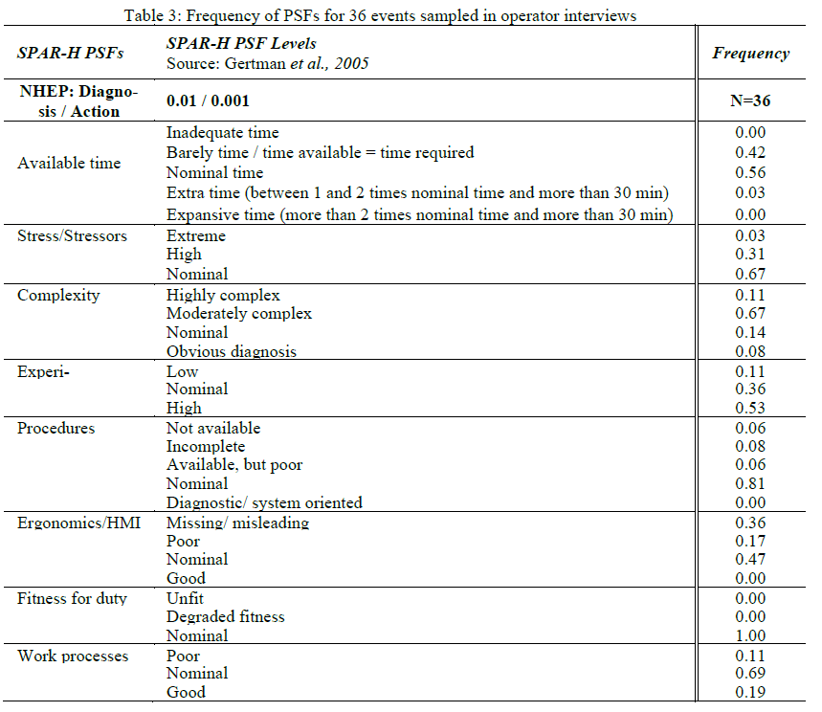
Annex2: Frequency of PSFs (PSF distribution)

